Slide 1
“IMPACT OF REALITY SHOWS ON YOUTH”
Yadav Priti Satyanarayan

Slide 2
OBJECTIVES
To study the behavior of the viewer's towards reality shows
To know the future of reality shows
To study the perception of the viewers towards reality shows

Slide 3

INTRODUCTION
Reality television is a genre of television programming that documents purportedly unscripted real-life situations, often starring unknown people rather than professional actors. Reality television emerged as a distinct genre in the early 1990s with shows such as The Real World, then achieved prominence in the early 2000s with the success of the series Survivor, Idols, and Big Brother, all of which became global franchises. Reality television shows tend to be interspersed with "confessionals", short interview segments in which cast members reflect on or provide context for the events being depicted on-screen; this is most commonly seen in American reality television. Competition-based reality shows typically feature gradual elimination of participants, either by a panel of judges, by the viewership of the show, or by the contestants themselves.

Slide 4
Advantages of reality shows
Ordinary men attaining stardom: We see real people performing daredevil stunts or showcasing their skills. Viewers come to know about them and appreciate their performance. In addition, reality TV stars become very popular within a very short period of time. They do not need any Godfather to become successful in the show biz but use their talent to achieve success.
Start of the successful career: Reality TV has given so many celebrities that have become big stars in their own rights. It was not possible in the past but now anybody can shot into fame within a very short period of time. In addition, audiences also become aware of the perils of different types of addictions such as alcohol and drugs in society.
Social issues: One of the most positive effects of the reality TV shows is that they address numerous social issues and introduce people to the ills plaguing the society. For instance, they have played a very important role in enhancing the women empowerment in society. With active discussion on the TV forums, the reality shows have made people more aware of what is happening in their vicinity.
Cost of the shows: Creating reality TV shows is not an expensive proposition and brings more bucks for money in comparison to the sitcoms and the soap operas.

Slide 5
Disadvantages of reality shows
Scripted shows: The majority of so-called reality shows are scripted and everything is closely doctored. Initially, people fell for the bait but now audiences understand that stories are developed well in advance. Some of the fights on the television are staged to increase the ratings of the show.
Harmful effect on teen: The new generation of reality TV celebrity stars does not thrive on talent but use sensationalism to always be in the news. One of the worst effects of their action is on teens who try to emulate their behavior. Stunts that are performed on televisions under controlled conditions are imitated by the people in real life resulting in death. Some of the shows where contestants participate to win prizes show them in poor light as they use meanness and greed to outdo each other. The negative traits can manifest themselves in the audiences and create behavioral problems.
Abusive shows: Liberal doses of abuses are hurled on the shows because the directors think that more and more people will watch them. It is a huge mistake because bad words are caught by teens and kids affecting their personality as well as behavior.

Slide 6
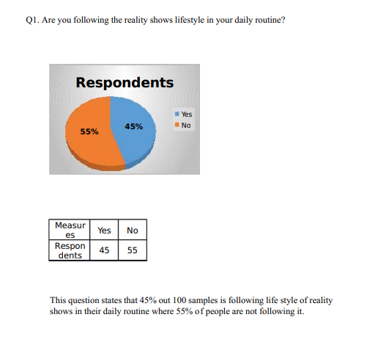
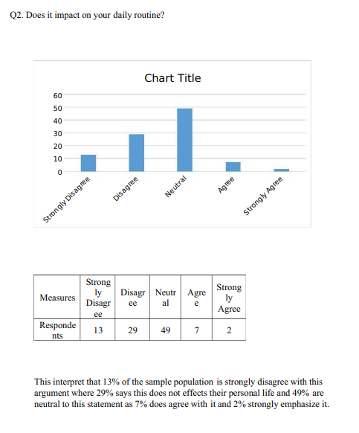
DATA AND INTERPRETATION

Slide 7
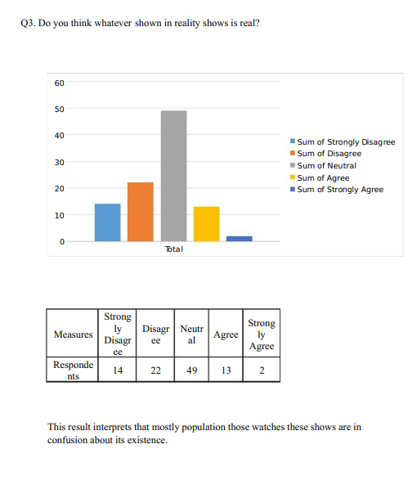
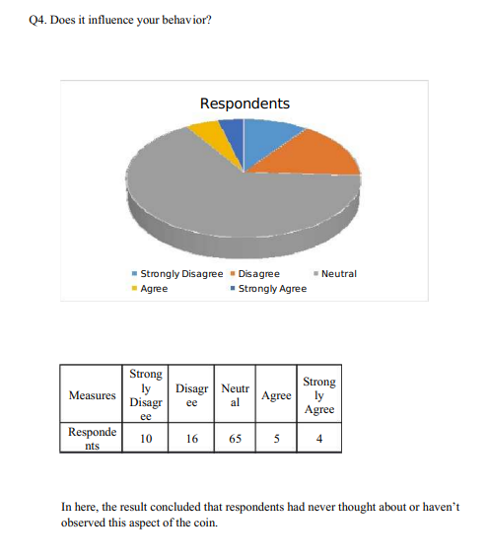
DATA AND INTERPRETATION

Slide 8
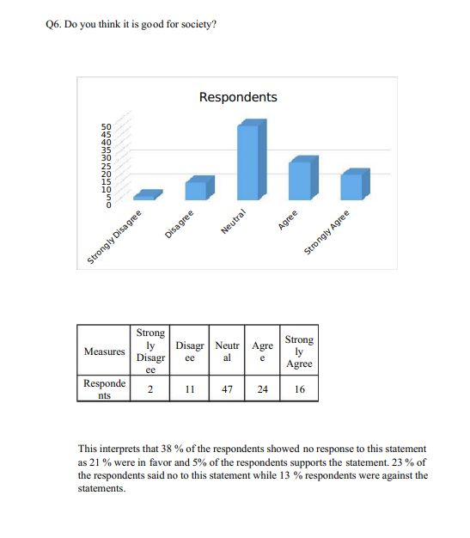
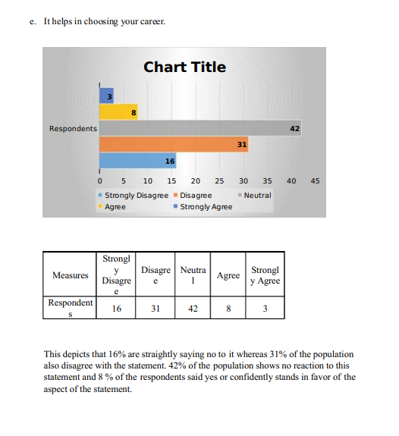
DATA AND INTERPRETATION

Slide 9

FINDINGS AND CONCLUSION

Slide 10
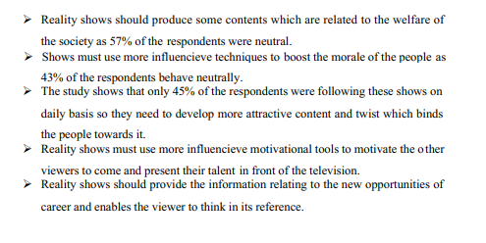
SUGGESTIONS

Slide 11
Thank You

